Slide 1
Unit 1
Proud to be an American

Slide 2
What is Civics?
The study of our rights and responsibilities as citizens of our country
We have Duties
Ex. Jury duty, follow laws
We have Responsibilities
Ex. Voting, treating others as we would be treated

Slide 3
What is a citizen?
Someone who swears allegiance to a country
A legally recognized subject of a country, whether born there or naturalized
naturalized= weren’t born in the country but went through the process to become a citizen
Provides stability and belonging

Slide 4
Defining citizenship in the United States
The 14th Amendment defines citizenship
What is jurisdiction?
An area of power
Passed after the Civil War
Meant to protect our civil rights

Slide 5
Civil Rights v Civil Liberties
Civil Rights: The right to be treated fairly regardless of race, color, creed or disability
No segregation, ramps for wheelchairs
Civil Liberties: Basic rights guaranteed in the Bill of Rights
Freedom of speech, religion, etc.

Slide 6
How to be a citizen of the United States
Alien – Foreign born. Not from an area but they are legal
Undocumented Immigrants – People who are in a country and haven’t done the paperwork yet (illegal status but can be temporary)
Refugees – People who are fleeing a conflict and have no country they can call home
Automatic Citizenship – Natural Born Citizen
Jus Sanguine: one or both parents are citizens (by blood)
Jus Soli: born on U.S. soil but parents weren’t (by soil)

Slide 7
Naturalization – foreign born
File with CIS = Citizenship and Immigration Services (used to be INS)
Can apply after living here for 5 yrs., or 3 yrs. if married to a citizen, live in state for 3 months and 18 yrs. old
If an applicant has children under 18 they automatically become citizens too.

Slide 8
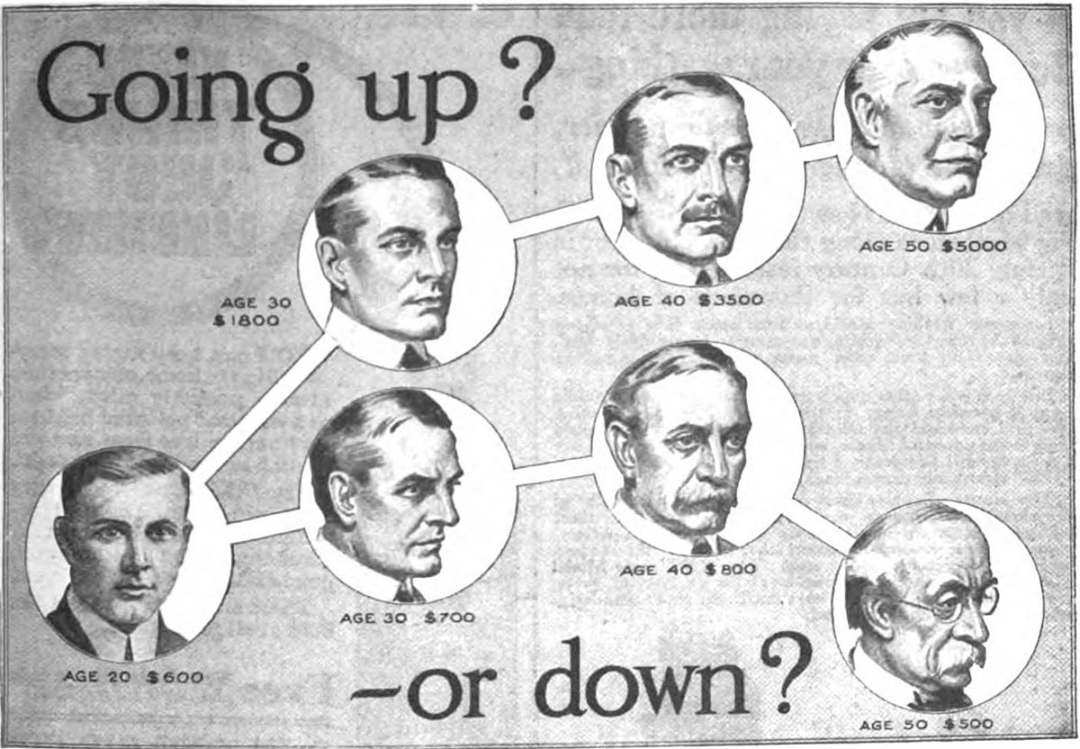
Why do people immigrate?
God – Religious Freedom
Gold – freedom to pick career/make money
Glory – the movement up the socioeconomic ladder

Slide 9
A Nation of Immigrants
American society represents people who have come from all over the world.
America has become increasingly diverse
Our national motto: E Pluribus Unum – Out of many; one. Out of many cultures, we are one country
Tolerance – We deal with and accept things that we don’t normally agree with.

Slide 10
A Nation of Immigrants cont.
The National Identity comes from shared political beliefs such as…
Representative Democracy- People pick someone to make decisions for them in government
Direct Democracy – People make decisions on laws, etc. (seen at the local levels)

Slide 11
Ellis Island
The station where millions of people immigrated in the late 1800s and early 1900s
Boats passed the Statue of Liberty
Before WWII, all immigrants who entered the country were granted citizenship
After WWII, America started to limit the numbers allowed into the country = quota

Slide 12
How immigration changes America
Melting Pot Theory = All cultures blend together creating one hybrid culture.
Assimilation = immigrants lose their identity
Ex. Halloween
Salad Bowl Theory = The different cultures retain their identity but join the larger culture.
Diversity = respecting differences

Slide 13
Diverse Culture and Conflict
Racism, Sexism, Ageism – belief that one group is superior to another
Affirmative Action – policy that helps minorities get jobs or into schools (tries to curb inequalities based on race)
U of CA v Bakke = No quotas in affirmative action

